Slide 1
WORLDWIDE HOTEL RESERVATION TRENDS

Slide 2
Team
Daniela Rojas
Eduardo Casas
Miguel Rodríguez
Francisco Rodríguez

Slide 3

Description

Slide 4

The current project aims to analyze the booking trends worldwide from 2015 to 2017. We will explore insights on 3 axis mainly:
Country
Type of customer
Type of hotel.

Slide 5
Research Questions to Answer
What are the trends per country?
What are the trends per type of hotel?
What are the trends per type of customer?
Datasets to Be Used
This project uses the dataset from [Hotel Booking Demand]
(https://www.kaggle.com/datasets/jessemostipak/hotel-booking-demand/data).
You can find more details about the dataset at the provided link.

Slide 6
Script

Slide 7
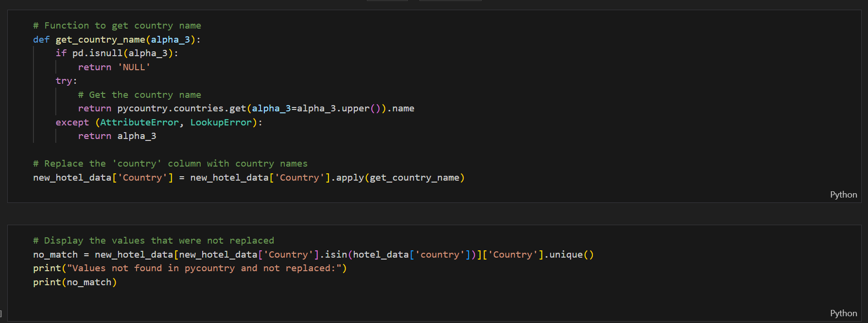

Slide 8
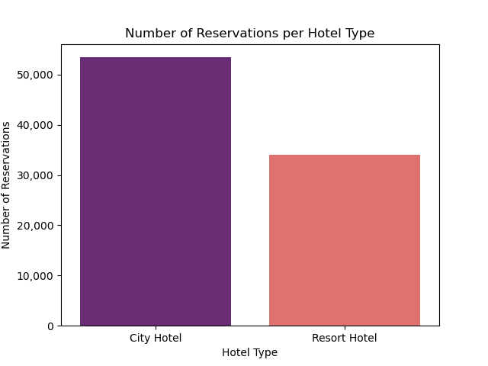
Number of Reservations per Hotel Type

Slide 9
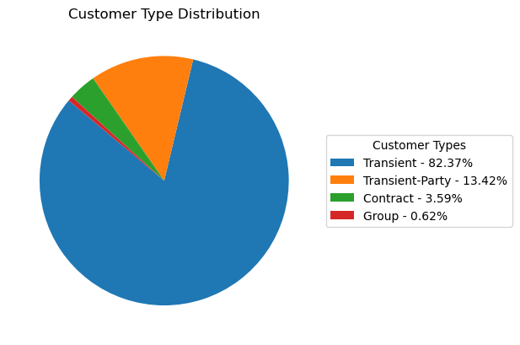
Customer Type Distribution

Slide 10
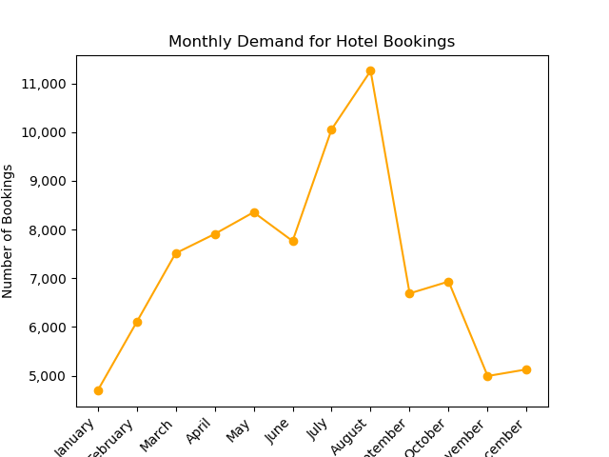
Monthly Demand for Hotel Bookings

Slide 11
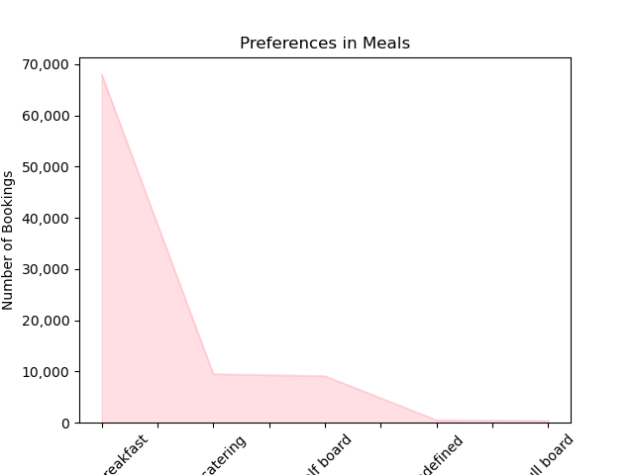
Preferences in Meals

Slide 12
Trends by Country
High Bookings: The United States, China, and several European countries show high demand.
Cancellations: Portugal, the United Kingdom, and Spain have high cancellation rates; further investigation is needed to reduce them.

Slide 13
Trends by Type of Hotel
Popularity: Urban hotels are more popular than resorts due to their accessibility.
Room Type: There is a greater preference for standard rooms over suites.

Slide 14
Trends by Type of Customer
Customer Types: Most are transient customers, with fewer group or contract customers.
Market Segments: High use of online travel agencies and offline tour operators.

Slide 15
Thank you

